Slide 1
Week 6 (Lab 5 – Atmospheric Soundings)
TA: Hannah Daley
atmos.umd.edu/~hmdaley/AOSC201/

Slide 2
Please spend the next five minutes reading the background information (pg 25 and 26)… underlining is encouraged as the background covers many of the answers.

Slide 3
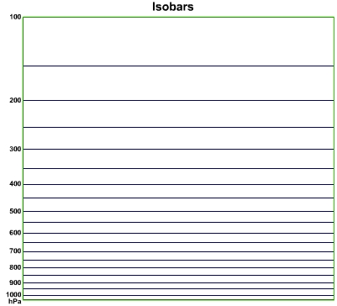
Isobars: lines of constant pressure Vertical lines As elevation increases, pressure decreases Ground is approx. 1000mbar

Slide 4
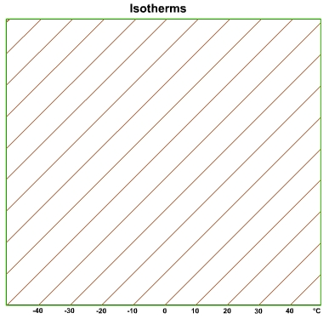
Isotherms: lines of constant temperature right leading diagonal lines

Slide 5
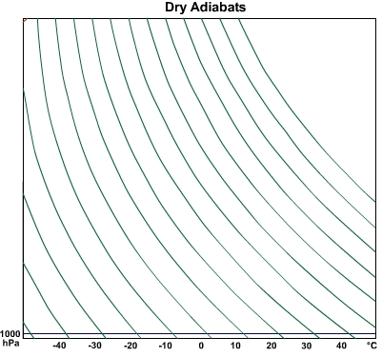
Dry adiabats can tell us how a parcel will be heated or cooled when lifted (change in pressure). Curved, left ward diagonal lines

Slide 6
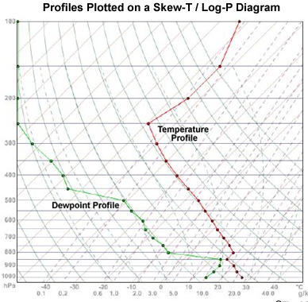
Moisture/ Dry
Dew point is the temperature at which water will condense.
Thus when the Temperature equals the Dew Point condensation occurs
The closer Temperature is to the dew point the more moisture there is in the atmosphere.
Similarly, the further they are apart the drier the atmosphere is.

Slide 7
Atmospheric Stability
The atmosphere is considered “stable” when there is minimal vertical motion
Large lapse rates limit vertical motion by capping it.
The atmosphere is most stable where there is the strongest (steepest) temperature inversion.

Slide 8
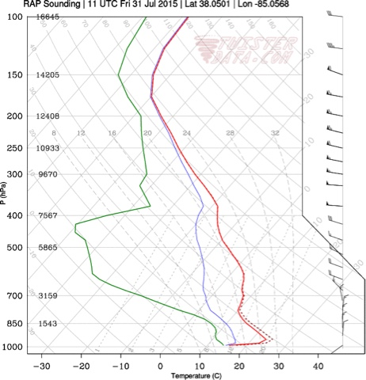
Radiation/Nocturnal Inversion
Occurs overnight
Surface is cooling and emitting heat energy (infrared), making the surface layer cooler than the air above.
Closest to Surface

Slide 9
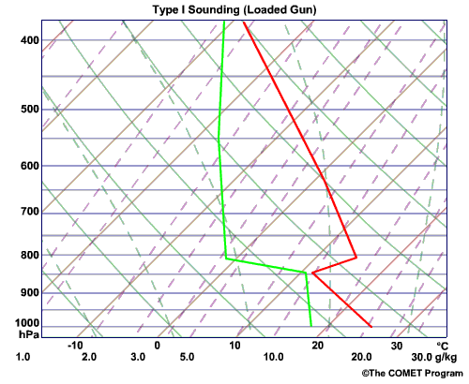
Capping Inversion/Subsidence
Occurs in the troposphere if there is sinking air
Air cannot rise above this inversion
Second of the three inversions you are looking for

Slide 10
Tropopause inversion
Normally occurs between 100 mb and 250 mb (highest of the three)
Air cannot rise above this inversion
Note that inversions are areas where temperature is constant or increases with height. The tropopause inversion tends to be when temperature is constant

Slide 11
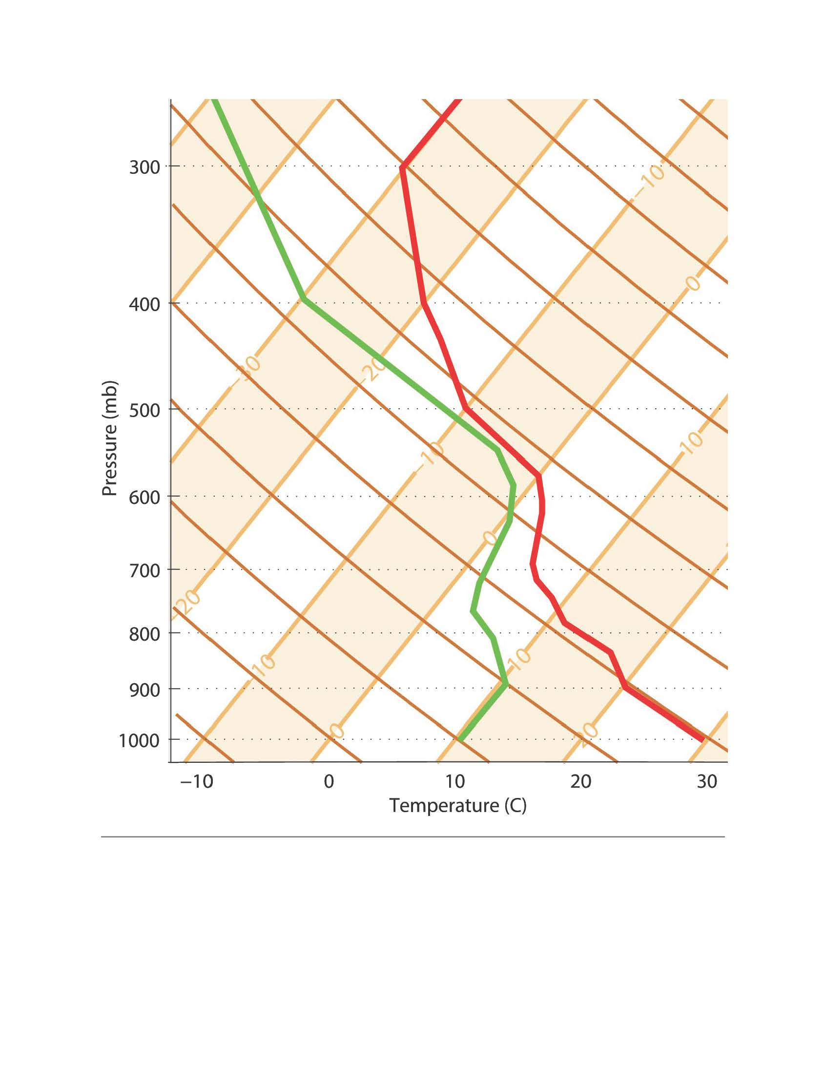
How to find temperature if air is lifted
Follow the dry adiabatic line up or down to the new pressure
Example. If my initial condition is
0 C at 700 mbar, and I want to know the temperature if the parcel is lifted to 600 mbar pressure.
..-12C
Note: cooler if lifted, warmer if dropped

Slide 12
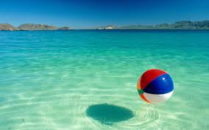
Buoyancy
Will it float? Its all about density!
Positive Buoyancy (rising up). If the ball was released under water
Negative Buoyancy (sink). If a rock was tossed in the water.
Neutral Buoyancy (stationary). The ball floating on top of the water.

